Slide 1
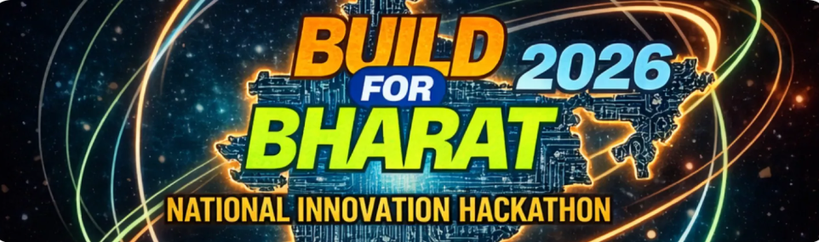

Responsible E-Waste Management
Tracking electronic devices from purchase to recycling using digital identity
Team Name: NextGen Bharat
Problem Statement No. : 5
“Addressing the Growing E-Waste Crisis ”
Team Members:
Shubham Singh (Team Leader)
Manjot Singh
Abhinab Jana
Abhishek Chaturvedi

Slide 2
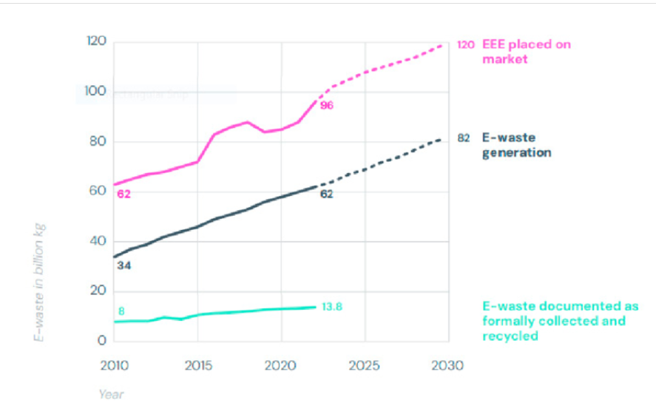
Problem Overview
The Growing E-Waste Crisis
India’s Growing E-Waste Crisis Needs Immediate Action
India is one of the fastest-growing producers of electronic waste due to rapid digital adoption, short device lifecycles, and rising consumer demand.
According to the Global E-Waste Monitor (UN & ITU), the world generated 62 million metric tonnes of e-waste in 2022, but only 22.3% was formally recycled.
In India alone, e-waste increased by 72% in just 5 years, reaching ~1.75 million metric tonnes in 2023–24, while a majority of waste is still handled by the informal sector using unsafe methods.
Source
https://www.researchgate.net/figure/Global-E-Waste-Generation-and-Recycling-Rates-Source-Global-E-waste-Monitor-2024-64
The lack of device-level tracking, citizen awareness, and structured recycling results in severe environmental pollution, health risks, and loss of valuable resources.

Slide 3

Global Comparison
Gaps in Existing E-Waste Management
Aspect | India | United States | China
Device tracking after sale | No device-level tracking | Limited (state / brand programs) | Partial (policy-driven, not universal)
Recycling ecosystem | Informal sector dominates | Mostly formal, uneven adoption | Formalizing, informal still exists
Citizen guidance & incentives | Very limited | Take-back & buy-back programs | Govt campaigns, regional variation
Govt data visibility | Fragmented, delayed | State-level, not centralized | Centralized policy data, not real-time
India lacks device-level visibility and citizen-centric systems compared to global peers, creating a critical gap in responsible e-waste management.

Slide 4
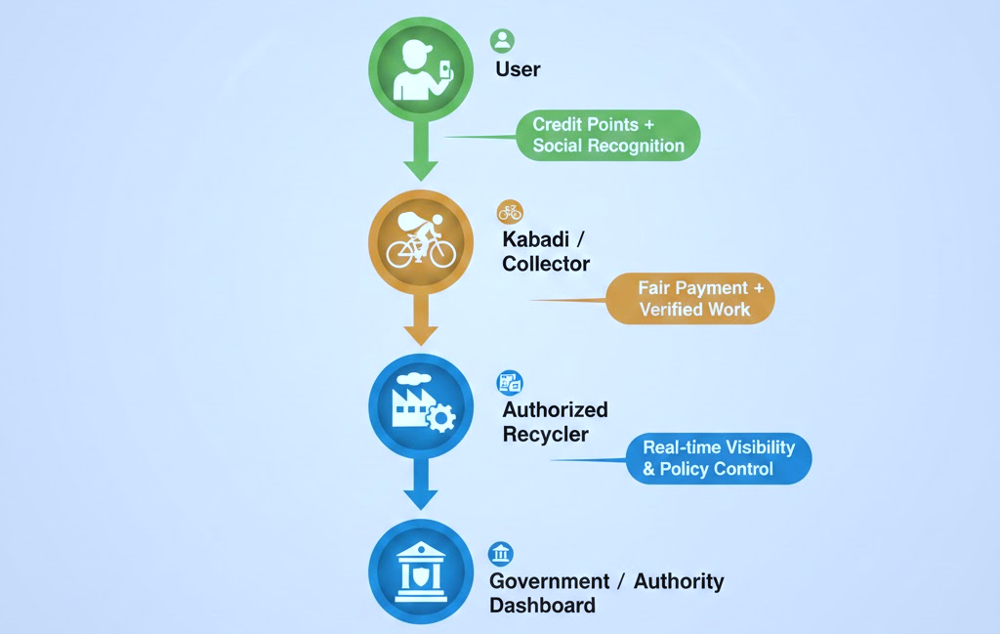
Our Proposed Solution
Digital Product Passport with Incentive-Driven E-Waste Tracking
Core Description:
We assign every electronic device a digital identity (QR/Unique ID) and connect users, kabadi/collectors, and authorized recyclers through a transparent, incentive-driven tracking system.
The system rewards responsible disposal while enabling real-time visibility for authorities.
Flow of Solution:

Slide 5
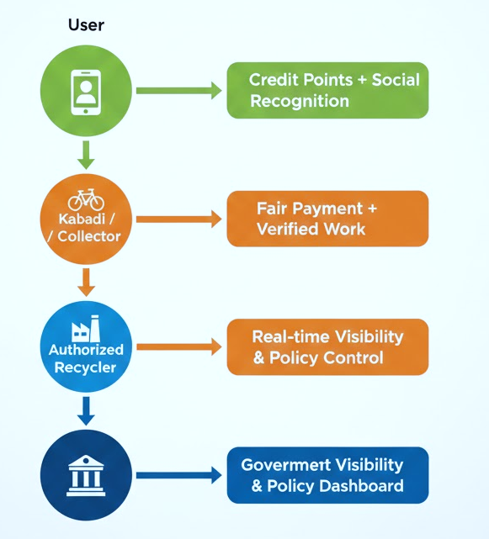
How the System Works (Step-by-Step)
End-to-End Lifecycle Tracking with Incentives
Digital Passport Creation
Each device is assigned a QR/Unique ID containing basic lifecycle and recyclability data.
User-Initiated Responsible Disposal
User scans QR to receive recycling guidance and earns credit points for responsible action.
Kabadi / Collector Verification
Collector logs device pickup through the app and receives verified payment for safe collection.
Authorized Recycling & Recovery
Recycler updates dismantling and material recovery details into the system.
Impact & Compliance Monitoring
Government dashboard tracks recycling volumes, pollution reduction, and compliance in real time.

Slide 6






Technology Stack
FOR MVP
Frontend : React.js (Web Application)
Used for user, collector, and recycler interfaces
Backend : Node.js + Express.js
REST APIs for device tracking, incentives, and lifecycle updates
Database : PostgreSQL
Central storage for device passports, user actions, and compliance logs
QR & Identity : QR Codes + Unique Device IDs
Enables low-cost, scalable device identification and tracking
FINAL SOLUTION
While the initial implementation is web-based for faster deployment, the system is designed to evolve into a mobile application to provide citizens, collectors, and recyclers with easier access, offline support, and location-based services.

Slide 7
Innovation & Impact
Innovation
Device-level digital identity for e-waste lifecycle tracking
Incentive-driven model rewarding citizens and kabadi/collectors
Integration of informal collectors into a formal, traceable system
Real-time dashboards enabling data-driven governance
Impact
Reduces improper disposal and environmental pollution
Improves material recovery and supports circular economy
Creates safer, more dignified livelihoods for collectors
Enhances government visibility and regulatory enforcement
Policy & National Alignment
Supports Atmanirbhar Bharat
Aligns with UN SDG 12: Responsible Consumption and Production
Complements government e-waste regulations with digital transparency

Slide 8
Feasibility & Scalability
Feasibility (MVP Ready)
Uses proven, open-source technologies (QR codes, web apps, cloud backend)
No new hardware required, leverages existing devices and workflows
Simple role-based system for users, collectors, recyclers, and authorities
Can be prototyped within hackathon timelines
Scalability
Designed to scale from city → state → national level
Supports multiple device categories (phones, laptops, appliances)
Cloud-based architecture enables high-volume data handling
API-driven design allows integration with municipal and EPR systems

